Slide 1




What Impacts
the Stability of Relationships?
Amelia, Hannah, Jacob, Ronit, John Marshall
BA 305 B1
Notes:
Intro: Ronit
Part 1: Jacob
Part 2: Amelia
Part 3: Jacob, Hannah
18, 19 - Jacob
20, 21, 22 - Hannah
Part 4: John

Slide 2
Table of Contents
The Data | Original dataset at large
Data Processing | Steps to how we cleaned our large dataset
Predictive Models | Models we ran on the algorithm and their performance
Model Selection & Performance | Our selected model and its performance

Slide 3
Purpose of "How Couples Meet and Stay Together"
Traditionality: Do traditional couples meet in the same ways that nontraditional couples meet?
1
Dating Apps: Does meeting online lead to more or less stability?
2
Cutting Ties: What are the rates of couple dissolution when looking at traditional vs nontraditional?
3

Slide 4
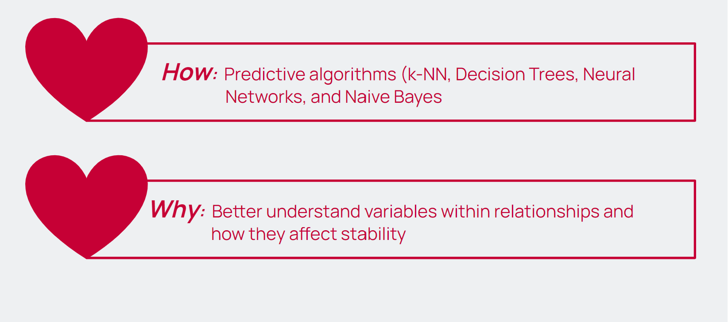
How to Determine If a Couple Will Stay Together?
How: Predictive algorithms (k-NN, Decision Trees, Neural
Networks, and Naive Bayes
)
Why: Better understand variables within relationships and
how they affect stability

Slide 5



Part 1
The Data

Slide 6
The Dataset (Before Cleaning)
Characteristics | Values
Variables (Multiple Duplicates & Very Obscure) | 500
Entries | 4002
Waves (1 - 6) | Initial Wave, 2009 Wave 2 - 5, Approx 1 Year Wave 6, 2017

Slide 7
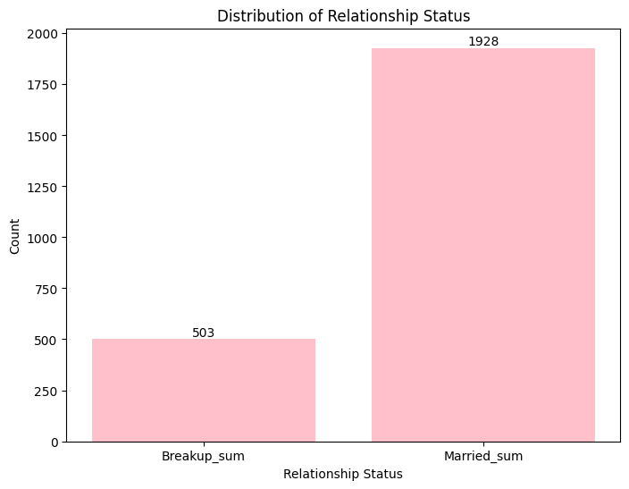
Notes:
Naive Rule

Slide 8
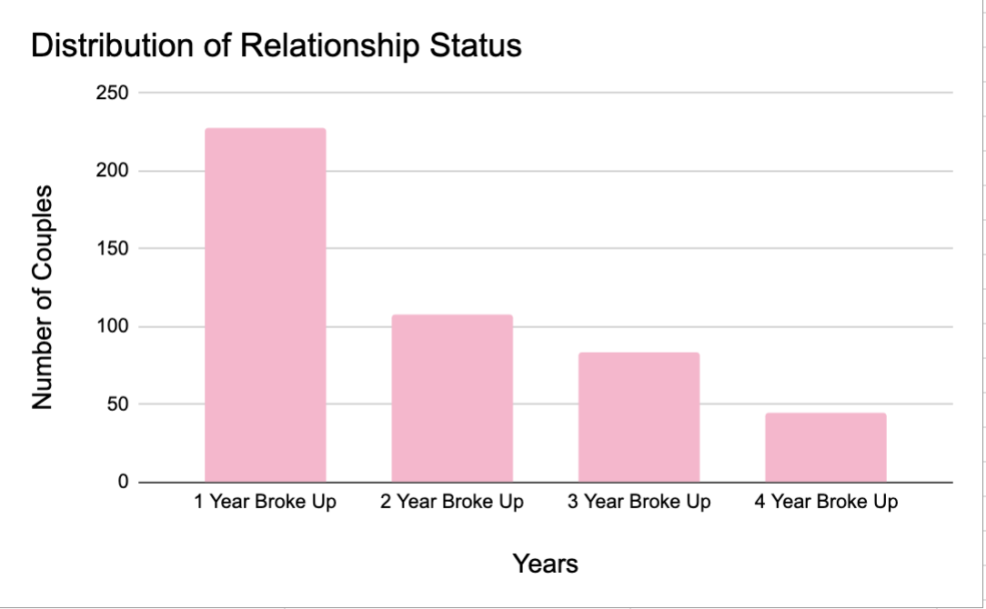
Notes:
Naive Rule

Slide 9
Section 2
Part 2
Data Processing
Data Processing

Slide 10
Step One: Significant Filter
4,002 Randomly
Selected Adults
3009 Adults Coupled @ Start
Of Survey
Oversampled self-identified gay, lesbian, and bisexual adults.
Note: We also separated the dataset by same sex couples (0 or 1), but this didn’t improve accuracy

Slide 11
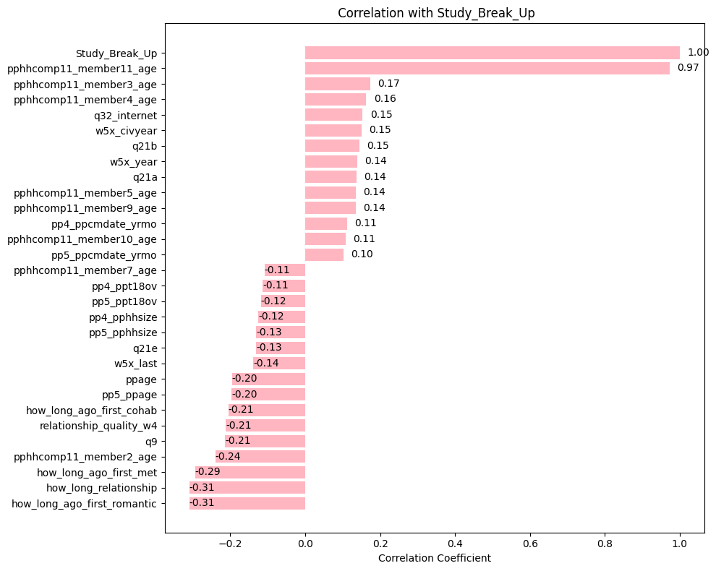
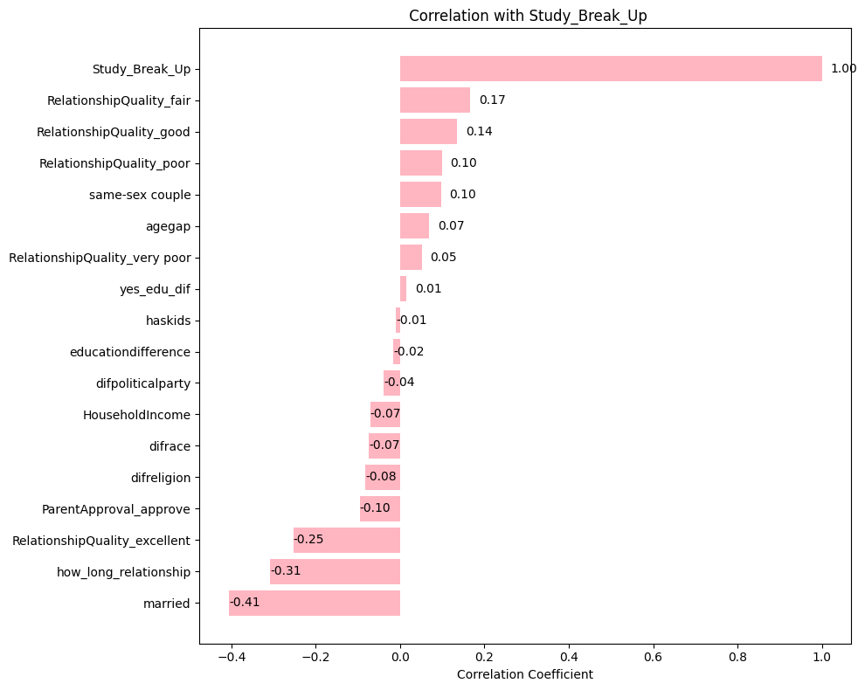
Understanding Our Correlations
Correlation between same variable
500 13
Variables
Only had Four Values
Lack of correlation surprised us
If these variables increased, they had a negative impact on a couple breaking up during the study

Slide 12
Step Tw0: Choosing Variables
Variable Name | Description | Value
Agegap | Age gap between partners | Numeric
Difrace | Is couple a different race from one another? | Binary
Difpoliticalparty | Does couple have different political views? | Binary
Difreligion | Does couple hold different religious values? | Binary
How_Long_Relationship | The length of the relationship | Numeric
Household_Income | How much the respondent makes | Numeric
RelationshipQuality | How respondent evaluates their relationship (5 Dummies) | Binary
ParentApproval_approve | Do parents approve of relationship? | Binary
Married | Was the couple married anytime before or during the study? | Binary
Notes:
Note the exact number of variables within the dataset (This isn’t all of the variables)

Slide 13
Step Three: Remove Missing Values
27
19
8
How_long_relationship
Assigned the mean values of the non-NaN column values.
AgeofPartner
Both assigned the value of the respondent. The resulting columns, “Agegap” and “Educationdifference,” were both zeros for those original NaN rows.
EDofPartner
Notes:
How_long_relationship (27 missing), AgeofPartner (19 missing), and EDofPartner (8 missing).

Slide 14

Our Outcome Variable
“Study_Break_Up”
Did the relationship end during the study or not?
Importance
Easier to track if a couple broke up during study at all than during specific points
Interested in what variables contributed to “healthy” relationships
Wanted to take different route from original Stanford study

Slide 15
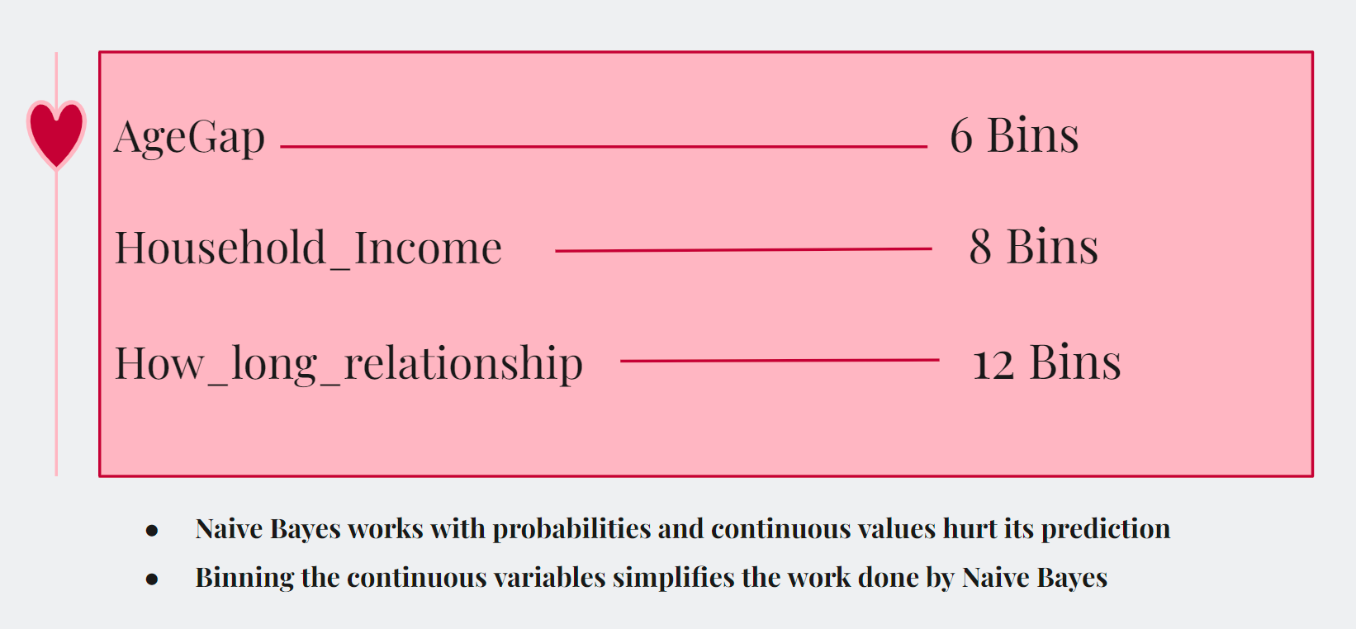
Binning (For Naive Bayes)
AgeGap 6 Bins
Household_Income 8 Bins
How_long_relationship 12 Bins
Sort values within a column from largest to smallest
Calculate the number of observations within each bin based off our total observations and the number of bins we write in the function
Assign labels to these new bins based off the range of values in the column
Assuring the bins don't overlap
Convert the new bin ranges to string format
Create new columns in the dataframe for the new bin ranges
Ex: “Household_Income_[80000, 92250)
Naive Bayes works with probabilities and continuous values hurt its prediction
Binning the continuous variables simplifies the work done by Naive Bayes

Slide 16
Section 2
Part 3
Predictive Models
Data Processing

Slide 17
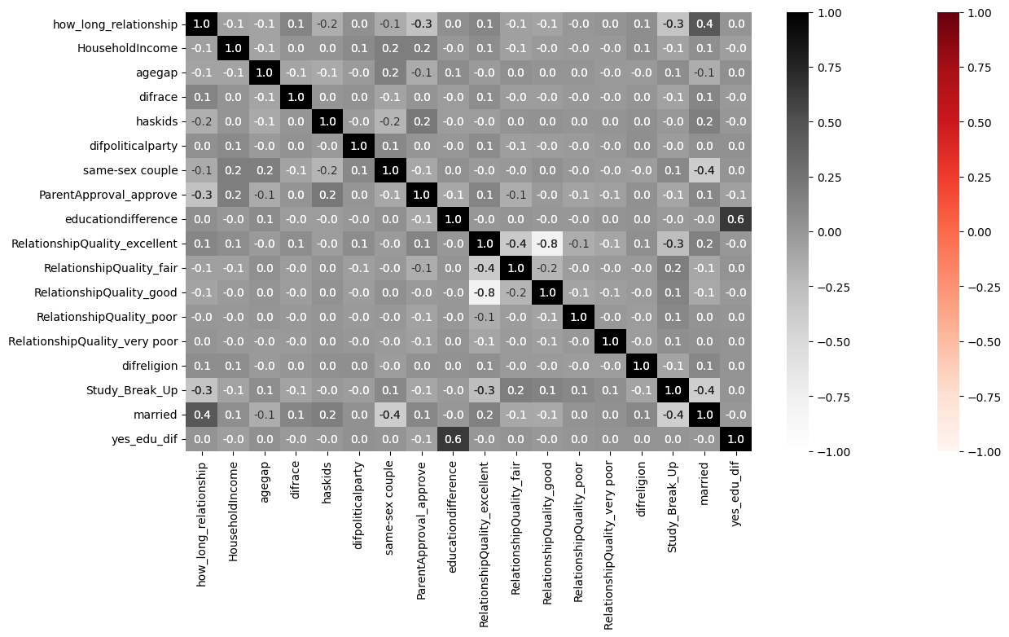
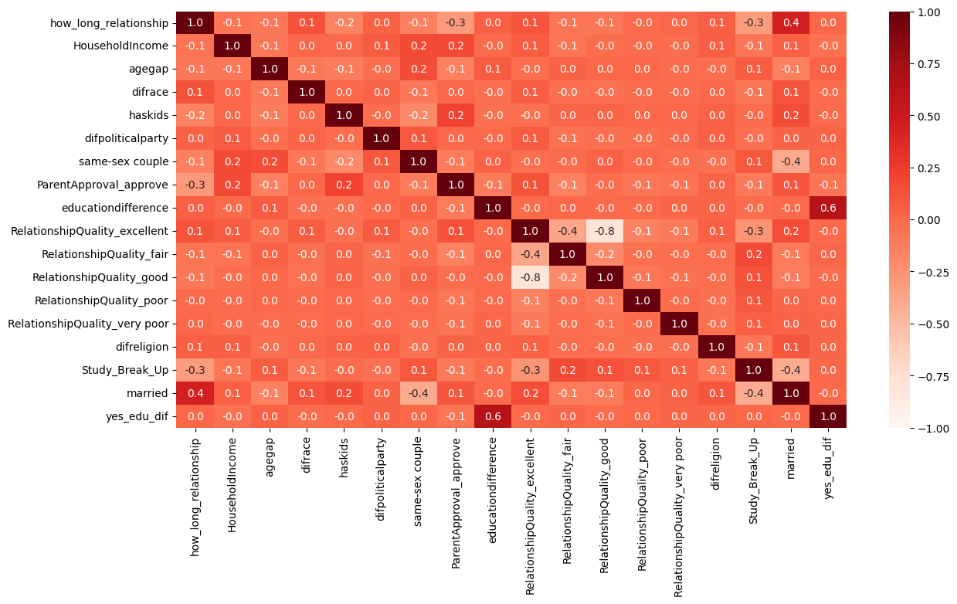
PCA Correlations
PCA - Principal Component Analysis
Correlation Between Variables for our Cleaned Dataset
No significant strong correlation
↳ except between features that stem from the same survey question.
Ex: “RelationshipQuality_good” and “RelationshipQuality_excellent”

Slide 18
During Actual 5 year Study…
2,506 Couples
Stayed Together
83%
503 Couples
Broke Up
17%
3009 Couples in Total
Notes:
Naive rule

Slide 19
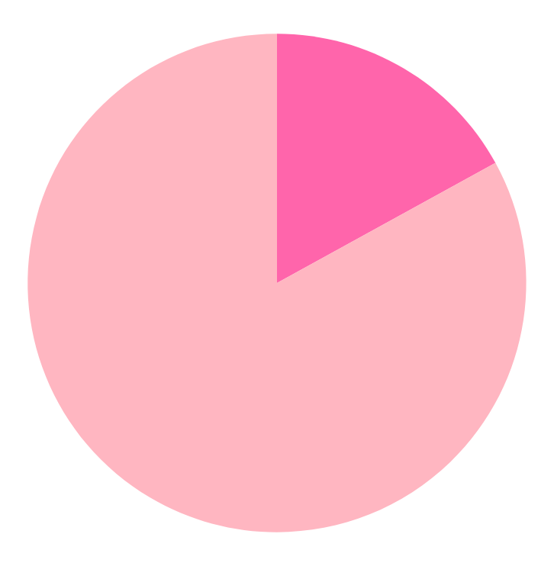
Naive Bayes
147 Wrongly Predicted
16.28%
Confusion Matrix | Actual Stayed Together | Actual Broke Up
Predicted Stayed Together | 672 | 80
Predicted Broke Up | 67 | 84
756 Correctly Predicted
83.72%
Testing Data Set Accuracy

Slide 20
K-Nearest Neighbors
142 Wrongly Predicted
15.73%
Optimize to k=14
Confusion Matrix | Actual Stayed Together | Actual Broke Up
Predicted Stayed Together | 741 | 11
Predicted Broke Up | 131 | 20
761 Correctly Predicted
84.27%
Testing Data Set Accuracy

Slide 21
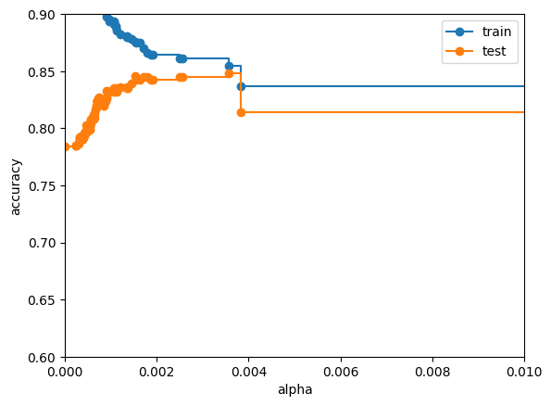
Decision Trees
Procedure
Ran a full, unpruned tree
Training Accuracy: 100%
Testing Accuracy : 78.405%
Cost-Complexity Pruning
Optimal Alpha Values
5 K-fold Cross-Validation
Pruned Tree, different alphas
Mean Accuracy: 84.5%
Confusion Matrix | Actual Stayed Together | Actual Broke Up
Predicted Stayed Together | 662 | 90
Predicted Broke Up | 78 | 73
Selected Alpha value of .0038

Slide 22

Neural Networks
Neural Network Function 1 | Neural Network Function 2
50 epochs | 80 epochs
12 Input Neurons | 16 Input Neurons
3 Hidden Layers within 8 neurons each | 4 Hidden Layers within 16 neurons each
Test Accuracy: 83.72% | Test Accuracy: 82.83%
Test Loss: 41.4% | Test Loss: 36.17%

Slide 23
Section 2
Part 4
Performance &
the Future
Data Processing

Slide 24

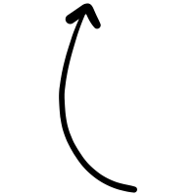
Random Forests
ST = Stayed Together
BU = Broke Up
Test Pruned Tree | Actual ST | Actual BU
Predict ST | 662 | 90
Predict BU | 78 | 73
Test Random Forest | Actual ST | Actual BU
Predict ST | 714 | 38
Predict BU | 99 | 52
Test Data Analysis
84.82% Accuracy
633 Nodes
Notes:
We have no preference in predicting one class over the other, we just care about overall accuracy within our data
Random forests are perfect for this decision
This tree is relatively complex with 595 nodes, attempting to capture the complexity within human relationships (complex but doesn’t overfit the data)
Possibly note the variables that were of the most importance to this model

Slide 25
Future Improvements
Logic: Take time to analyze more correlations of the
variables with our outcome variable
1
Use of PCA: With more variables, PCA becomes more necessary and incredibly help to our analysis
2
Time Constraint: Original data collection had ~5 year time frame… Longer = more accurate results
3

Slide 26

Future Use Cases & Concern
Use: Relationship counseling & premarital tests
(Both to understand stability and work out kinks of relationship)
Concern: Ethical concerns regarding consent, data storage,
& accuracy of the test score

Slide 27
Thank You
Any Questions?

Slide 28
Archive

Slide 29
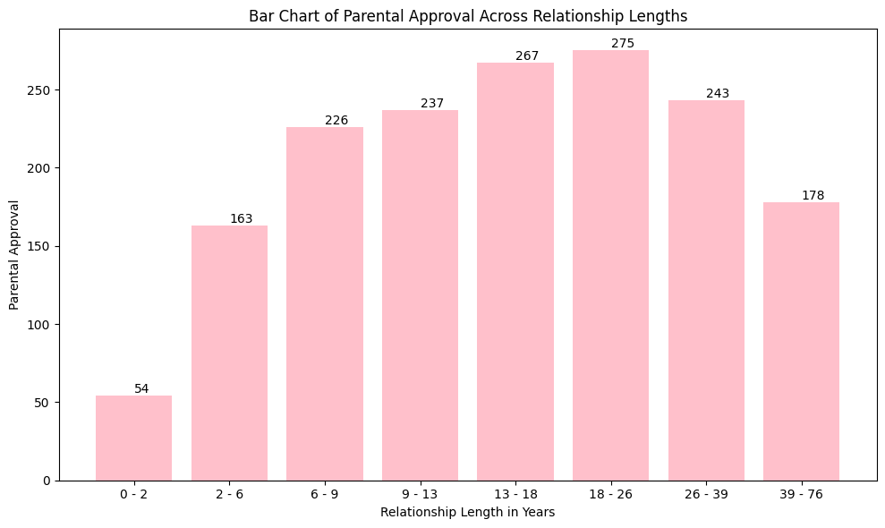

Slide 30
1 Year Broke Up | 2 Year Broke Up | 3 Year Broke Up | 4 Year Broke Up
228 | 108 | 84 | 45

Slide 31
Model Type | Test Accuracy | Precision TP/TP+FP | Sensitivity/ TPR | Specificity/ TNR | Fallout/ FPR
Pruned RF DT | 84.46 | 87.82 | 94.95 | 34.44 | 65.56
Pruned DT (K-5 Cross Fold) | 84.5 | 89.46 | 88.03 | 48.34 | 51.66
KNN, k = 14 | 84.27 | 84.98 | 98.54 | 13.25 | 85.75
NN | 84.05 | - | - | - | -
Binned NB | 83.72 | 90.93 | 89.36 | 55.6 | 44.37
Naive Rule | 83.28 | - | - | - | -
No Prune DT | 78.405 | 88.31 | 85.37 | 43.71 | 56.29
KNN, k = 1 | 77.18 | - | - | - | -

Slide 32
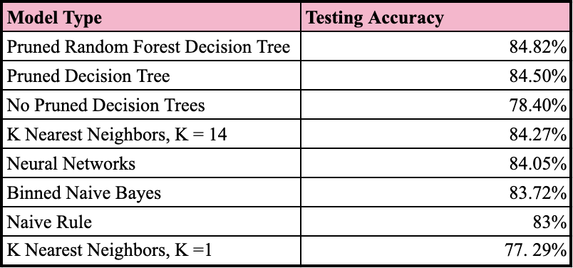

Slide 33
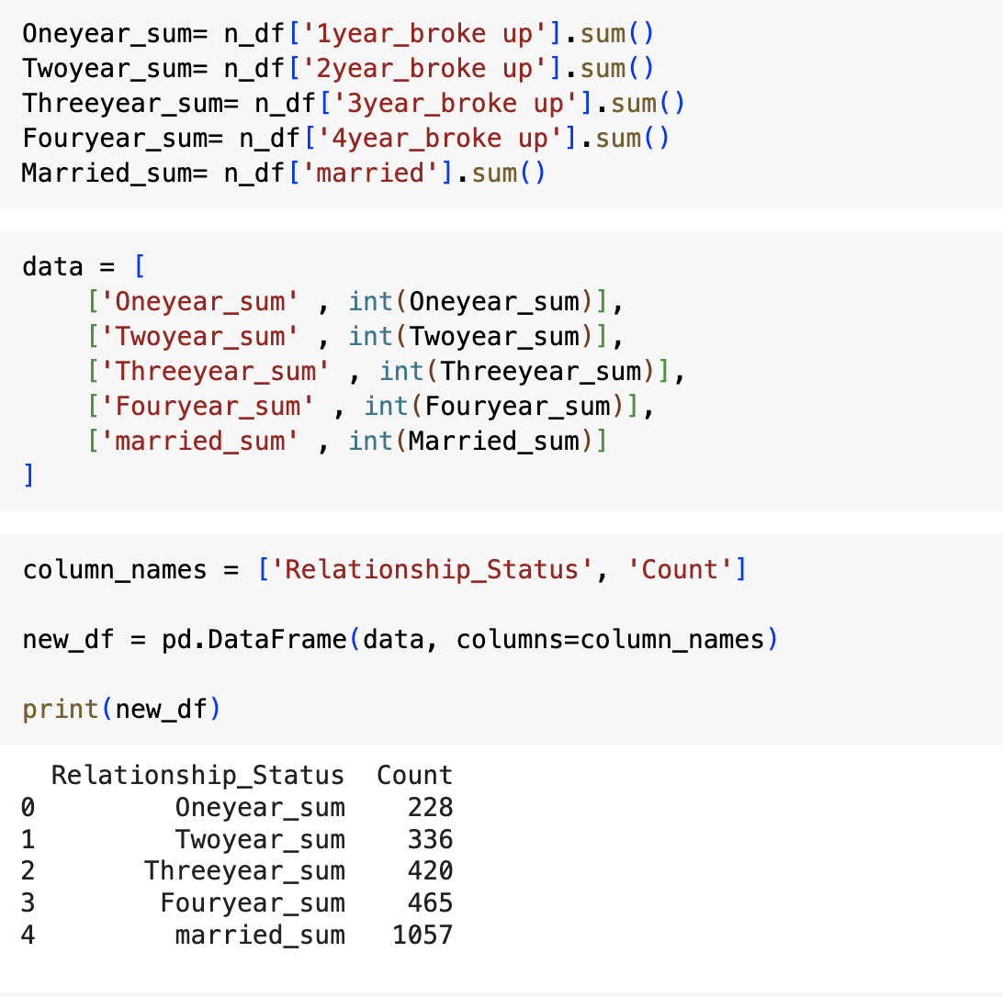

Slide 34
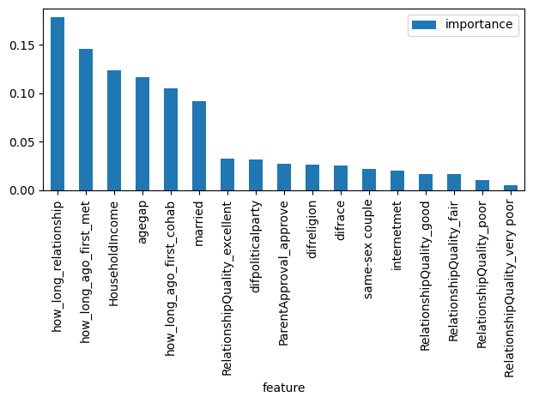
Importance of Variables in Random Forest

Slide 35
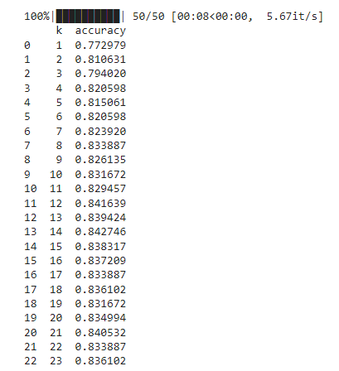
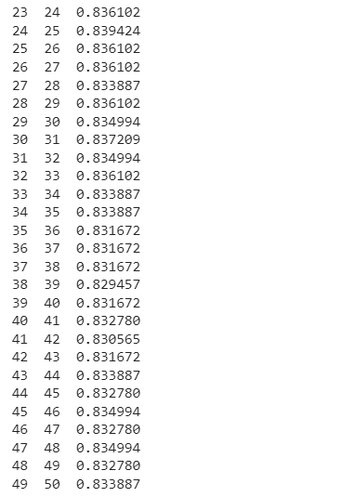

Slide 36
